Slide 1
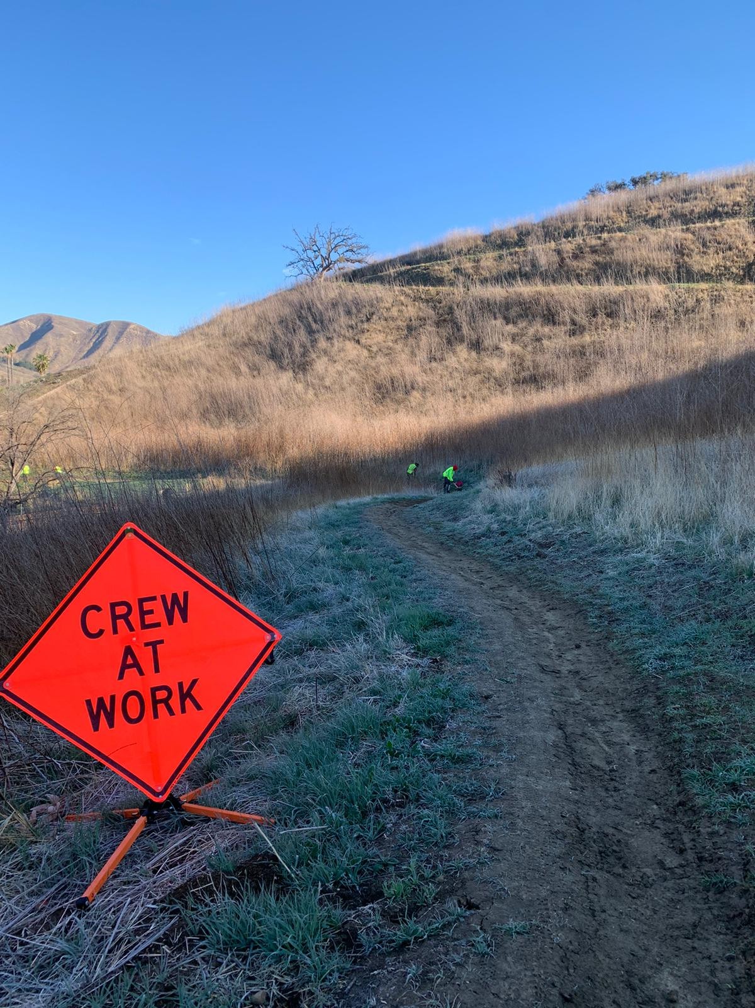
September 2020 “Bobcat” DR-National Dislocated Worker Grant (NDWG)
Bidders Conference
Wednesday May 26, 2021

Slide 2
Welcome and Introductions
MCS Executive Director: Dr. Starr
MCS Director of Finance: Mr. Maturan and Accounting Department: Ms. Muradian
MCS NDWG Program and MIS Manager: Mr. Khoshabou
R&D Department: Ms. Martinez, Ms. Scoble and Ms. Bradley
MCS Director of Development: Ms. Altounian

Slide 3
Today’s Agenda
Review IFB, specifically:
Timeline
Scope of work and contractor expectations
Submission requirements
Questions and Answers (those Q+A submitted today will be posted by Friday)

Slide 4
September 2020 NDWG “Bobcat Fire” Overview
This Invitation to Bid (IFB) has been articulated to procure multiple subcontractors to manage a 18 month Wildfire clean-up effort on City/EDD pre-approved September 2020 “Bobcat” Wildfire affected sites in incorporated and unincorporated Los Angeles County. Clean-up crews must be composed of local fire affected residents or WIOA eligible dislocated workers/unemployed workers (with further discussion on eligibility). Wildfire clean-up activities will vary slightly by site and each site will have a formal scope of work.
The anticipated term of contract is July 1, 2021 to December 30, 2022. Based on performance and funding allocations, additional terms may be granted.

Slide 5
Timeline
IFB Application Open Period: 5/17/2021 - 6/4/2021
Non-Mandatory Bidder’s Conference: Wednesday May 26th from 2:00 - 3:30pm PST
IFB Submission Deadline: Friday 6/4/2021, close of business (5pm PST)
Subcontractor Award Notification: Friday 6/11/2021, close of business (5pm PST)
Term of Resulting Contract: July 1, 2021 → December 31, 2022

Slide 6
Scope of Work Requirements 1-9 (pages 2-3)
Full-time work supervision for clean-up crews consisting of at least eight, but not more than 12 impacted residents or dislocated workers per crew. Due to COVID restrictions, larger crews may require additional transportation vehicles to ensure social distance is maintained in transit. Subcontractors may design crew size and work schedules as desired within these parameters, but please note that COVID restrictions and crew size may change;
All entry level crew participants may be paid up to $17.00 per hour (but not less than the City of Los Angeles minimum wage). Participant supervisors may be paid up to $19.00 per hour (but not less than the City of Los Angeles minimum wage). All clean-up work must be on pre-approved sites including, but not limited to, those sites listed in Appendix 2. Participant crew members and participant supervisors may not work more than 900 hours on this project unless otherwise granted approval. While MCS will track participant work hours, subcontractors will also be required to track hours for their crew members. Participant wages over the allotted 900 hours will not be reimbursed without prior approval;

Slide 7
Scope of Work Requirements 1-9 (pages 2-3)
3. Leadership/supervision of each work crew (i.e. Crew Supervisors);
4. Required equipment/tools/resources for workers, including COVID-19 PPE (see Appendix 3 for minimum recommended list);
5. Daily, round-trip site transportation for all workers and supervisors;
6. Weekly electronic work-site attendance sheet, crew work log or other documentation for daily or weekly work attendance;
7. Monthly worksite report and photos, including worksite and participant success stories (see Appendix 5 for Bobcat Fire Monthly Report template);
8. Electronic transmission of billing/invoicing portfolio including timesheets, payroll records, supply purchase receipts and expense supporting documentation to MCS Accounting;
9. Participation in site visits and/or virtual partnership meetings, share status updates on project worksites and crew members as needed/requested.

Slide 8
WIOA Eligibility (see Appendix 1)
Eligible participants for enrollment and employment under this NWDG are those who:
1. Reside within the declared disaster areas;
2. Were forced to relocate due to the disaster or emergency event;
3. Were temporarily or permanently laid off as a consequence of the disaster; or
4. Are long term unemployed (unemployed at the time of enrollment and unemployed more than 15 of the previous 26 weeks prior to enrollment).
All participants must be vetted by MCS and enrolled in WIOA services with Hollywood or Boyle Heights WorkSource Centers before being assigned to a crew. This program is open to all eligible residents of the City of Los Angeles. Through MCS and partners outreach efforts, residents regardless of geographic location in the City, should be considered equally for this opportunity.

Slide 9
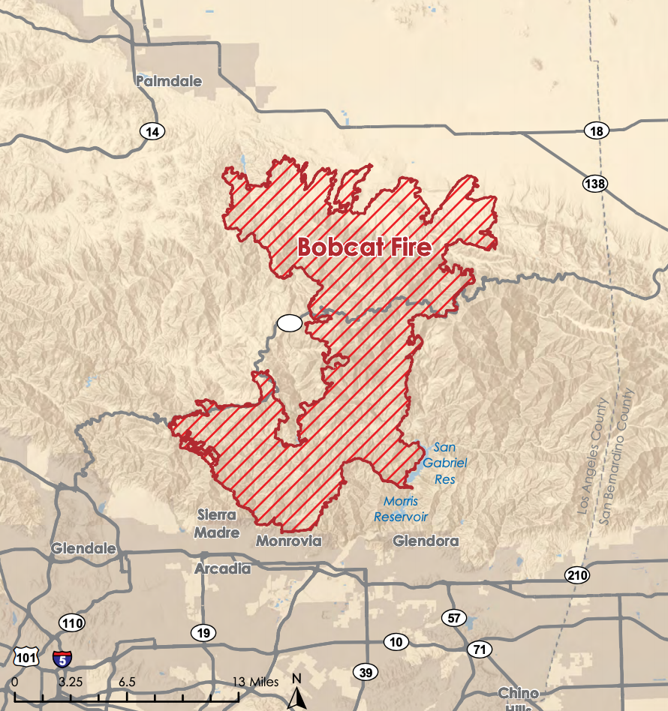
Worksites (see Appendix 2)
Potential Worksite Locations for Bobcat Affected Sites
US Forest Service: Angeles National Forest
Other sites are currently under review/approval

Slide 10
Required Monthly Reports (Appendix 5)
Upon successful completion of subcontract award, MCS will provide this template in Word format and through Google Docs. Completion of this monthly reporting template is required on or before the 5th of the month.
Bobcat NDWG Subcontractor Monthly Report Template
Due by the 5th of each month
(if crews worked on multiple sites during this reporting period, please list them individually and use multiple sheets if necessary for only the site questions portion of this report)
I. Site Questions:
Subcontractor Name:
Name of Site:
Address or Location Description:
Crew Supervisor Name:
Number of Crews:
Number of Crew Members:
Overall Scope of Work Description of Site (in approximately 100 words):

Slide 11
Template Continued...
II. Site Summary and Site Successes: Please describe what work was accomplished. Please also include quantitative metrics, even if estimates, on accomplished work and how many days were spent in work on a specific area. Supporting photos are required. Photos must have description captions. Additional photos are welcome but at least two photos (one before and one after) of the work being described must be included to correspond to the site summary/site success story. If there are any COVID related protocols or challenges, please describe them here as well.
Example: In the month of May, one crew of eight removed 30 snag trees (each approximately 15 feet tall); restored over 20 french drains back to pre-Woolsey fire working order; reset 15 campgrounds at Leo Carrillo State Park and restored 2-3 miles of trail at Malibu Creek State Park. For all completed work, please see attached before and after photos. All snag trees were felled by the crew supervisor, a certificated chainsaw operator. Crew members were provided with industrial chipper machine safety and usage training by State Parks. At the end of each workday transit vans are sanitized and prepared for the following day.
III. Site Photos (Before and After)

Slide 12
Template Continued...
IV. Participant Successes: Please feature one participant by first name and last initial and provide context for how they were hired, what personal and or employment barriers they’ve overcome and how either they are doing on-the-job or how they have transitioned out of the project to other related unsubsidized work. Please include participant photos, ideally photos of the participant engaged in on-site work. If crew members request anonymity, please use pseudo names.
Example: John S. was previously incarcerated for five years and found out about this program from his case manager, his first occupational re-entry training program was OSHA 10 under the 2018 Creek NDWG Program with MCS. John had previous fire camp experience but no paid work experience for his resume. John worked as a crew member for approximately six months and in May 2019 he was promoted to assistant site supervisor. As a young father, he now has a reliable source of income, has recently secured his own transportation and spends time on weekends with his daughter.

Slide 13
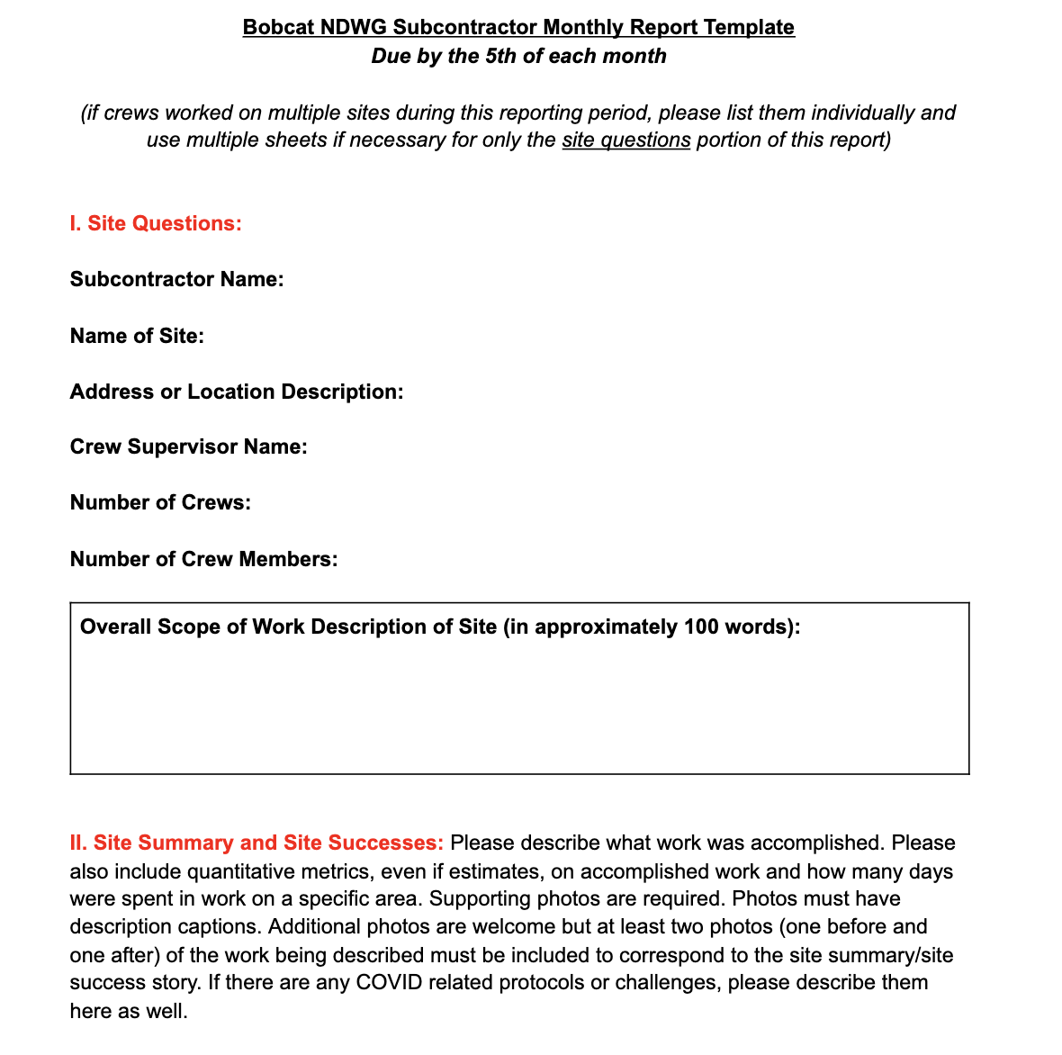
Visual of Entire Monthly Report (Page 1):

Slide 14
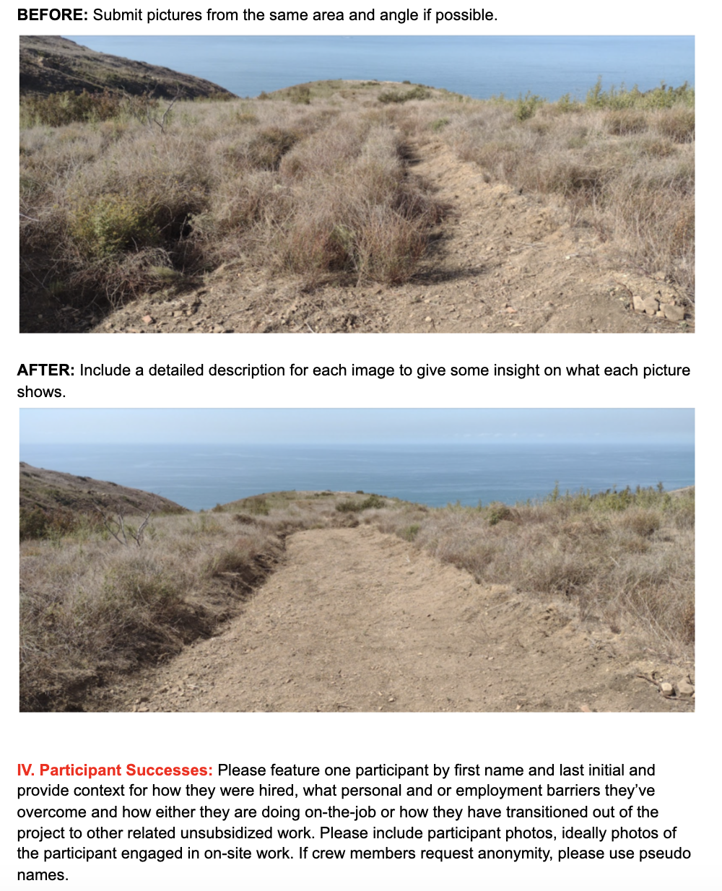
Example of Photos Required for Monthly Report (Page 2):

Slide 15
Recent Subcontractor Monthly Report:

Slide 16
Available Funding & Fiscal Requirements
Up to $500,000 is currently available for each subcontractor for the projected duration of the project. Subcontractors may bid for all or a portion of the available funding ceiling.
Should additional funds become available to this grant project, subsequent funding may become available to interested subcontractors procured through this solicitation. Based on performance additional funding will be awarded, an additional IFB response will not be required. Budgets may be submitted for up to 18 months. Monthly expenditure plans are required among other budget forms (see proposal package, Excel files).

Slide 17
Available Funding & Fiscal Requirements
Sub-contractors must ensure that at least 70% of the budget is dedicated to participant related costs (wages and fringe benefits, including workers compensation). It is possible that additional Bobcat Fire NDWG funds may be made available based on project performance and success.
Once the IFB has closed, MCS may request subcontractors to modify or revise budgets as needed.
At this time the number of participating subcontractors has not been determined.

Slide 18
Submission Format / Requirements
Proposals must include a cover letter acknowledging the scope of work of the IFB signed by an agent of the organization with binding authority to enter into a subcontract agreement.
Proposals shall include two program narratives
(1) demonstrated ability
(2) program design
In total, all proposal narratives (1-2) should not exceed six single spaced pages.
Proposals shall also include one set of budget forms, in Excel format.

Slide 19
Narrative Question #1
Narrative 1 Demonstrated Ability (5 points)
Include organization’s background and history on:
Facilitating and implementing successful work-crews dedicated to wildfire clean-up, trail maintenance, litter abatement and landscaping in Southern California (especially in excessive heat conditions)
Supervision and training of work-crews
Ability to recruit participants with barriers to employment
Ability to recruit adults that are actively seeking employment across the wide geography of the City of Los Angeles
Support and services for multi-barrier participants

Slide 20
Narrative Question #2
Narrative 2 Program Design (5 points)
Articulate your vision / plan for partnering with MCS to implement wildfire clean-up crews
Identity how you would structure crews (i.e. size of crews; supervisor to worker ratio)
Describe your current COVID-19 health and safety protocols and how such protocols would be incorporated into wildfire clean-up crews under this project
Describe your emergency response plan (i.e. chain of command, contact, emergency procedures, practice drills) in event of excessive heat, safety or other potential emergencies in the field
Describe your weather response plan (i.e. chain of command, contact, emergency procedures, practice drills) in event of excessive heat, rain, or poor visibility emergencies in the field
Describe your outreach plan and referral strategy to promote temporary employment to adult job-seekers with barriers across the City of Los Angeles

Slide 21
Budget Forms
Using the Excel budget templates provided, please complete the following:
Budget Summary Sheet
Budget Detail with simple narrative
Schedule of Personnel
Spending Plan Worksheet (18 months)
Please provide a copy of your Insurance Certificate with “Managed Career Solutions” named as a certificate holder with coverage types and policy thresholds as required in the IFB.
*MCS will also verify that all bidders are in good standing with the State of California and local area

Slide 22
Additional Requirements: COI Limits
Certificate of Insurance
Good standing (MCS to conduct check)

Slide 23
Electronic Submission
All responses are due as an electronic submission on or before Friday 6/4/2021 at 5PM PST.
Please send completed responses to:
Alexis Altounian, Director of Development aaltounian@mcslosangeles.com
With a copy to MCS’ Executive Director, Philip Starr pstarr@mcscareergroup.com
Second copy to bobcat@mcslosangeles.com

Slide 24
IFB Evaluation Criteria & Timeline for Award Notification
IFB Evaluation Criteria:
The bid which meets and or exceeds program deliverables with the most efficient budget design will be awarded a subcontract with MCS.
All bids will be reviewed out of a total maximum 15 points, with five points potentially awarded to each section.
The highest scored applications will be considered first.
Notices will be made by 6/11/21.

Slide 25
Bidder’s Questions
Previously submitted questions:
Can vehicles be purchased to transport crews?
No, unfortunately capital expenditures such as truck or van purchases can not be made with these funds. Monthly truck or van leases are allowable costs
Can wages for participants or supervisors be modified from what is in the IFB?
Yes, you may modify them slightly in your proposal but ultimately this decision will be made by The City of LA EWDD.

Slide 26
Live Questions

